Slide 1

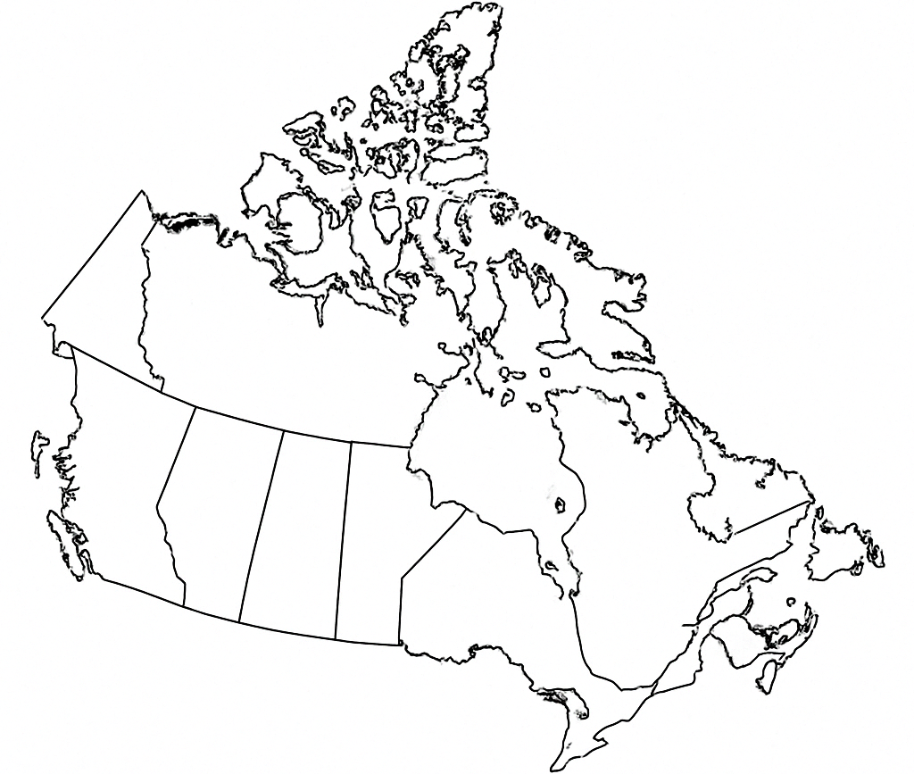
Nikolay Shlepov | MS DS Student | CU Boulder
Project Progress Presentation, April 2024

Slide 2
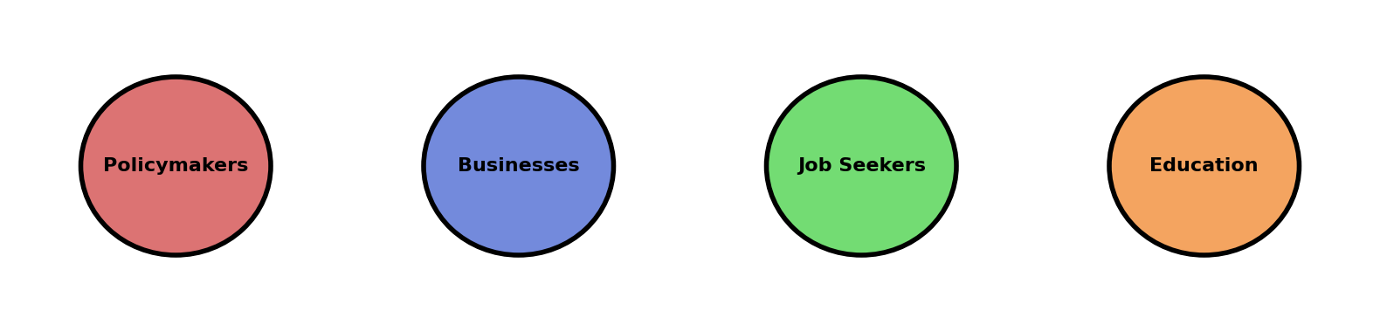
Problem Context
Wages are a key indicator of economic health, labor stability, and inequality
COVID-19, inflation, and technological changes have reshaped labor markets
Lack of structured, longitudinal, predictive wage studies in Canada
Critical for policymakers, businesses, educators, and job seekers

Slide 3
Project Summary
Analyzed wages in Canada (2016–2024)
Examined national, provincial, and regional disparities
Identified main wage drivers
Combined descriptive, unsupervised, and supervised methods
Tested the stability of wage structures from 2016 to 2024

Slide 4
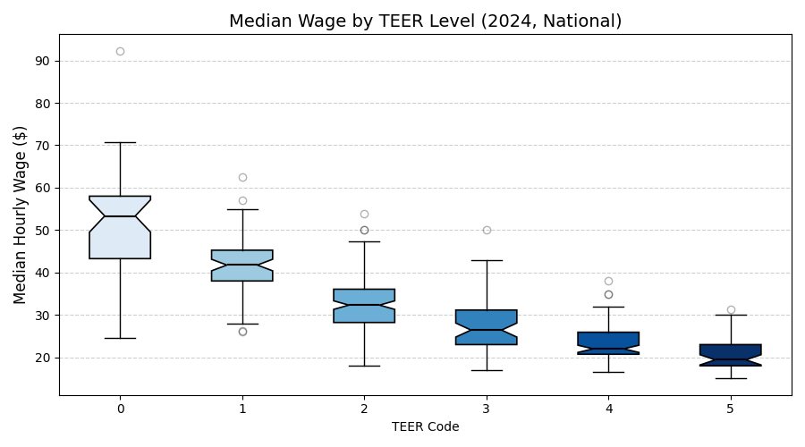
Key Findings
TEER level (Training, Education, Experience, Responsibilities) is the strongest predictor of wages
Occupational category (BOC) has secondary influence
Provincial effects are modest
Regional outliers exist but
are not dominant drivers
Wage structures remained
stable from 2016 to 2024

Slide 5
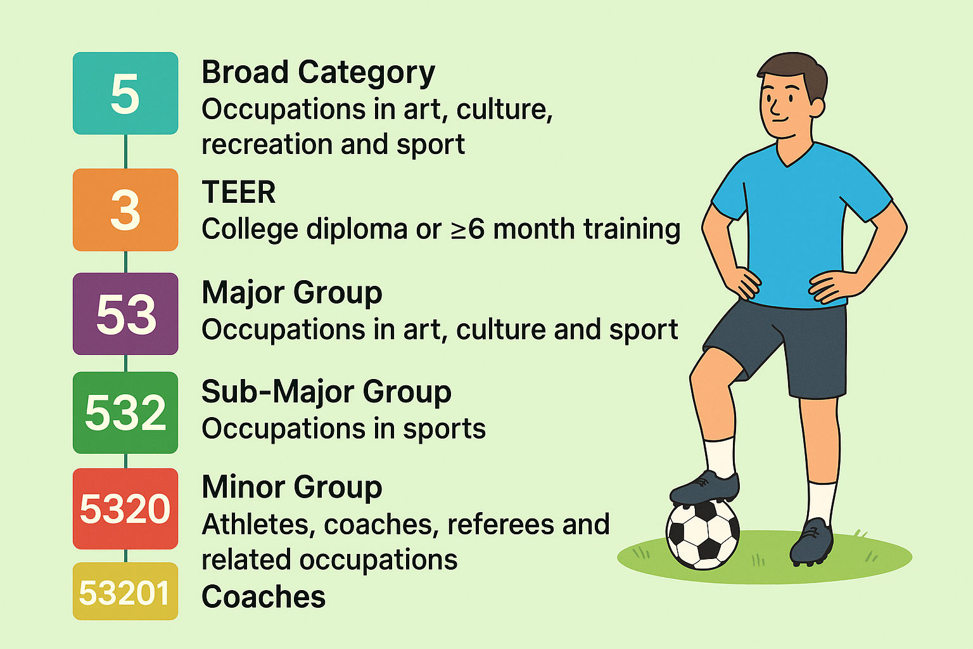
Inside NOC 2021

Slide 6


Methodology Overview
Collected and unified Canadian wage datasets (2016, 2020, 2024)
Mapped NOC 2016 codes to NOC 2021 codes
Engineered features: TEER, Broad Category, Major Group
Conducted Descriptive Analysis, Clustering and Predictive Modeling
Evaluated correlation, clustering coherence, and model accuracy

Slide 7
Data Source and Preprocessing
Source - Government of Canada wage reports (open.canada.ca)
Standardized column names and formats
Mapped occupations from NOC 2016 to NOC 2021
Cleaned occupation titles and province names
Filtered outdated entries and handled missing data
Created unified dataset (11,448 records) ready for analysis

Slide 8
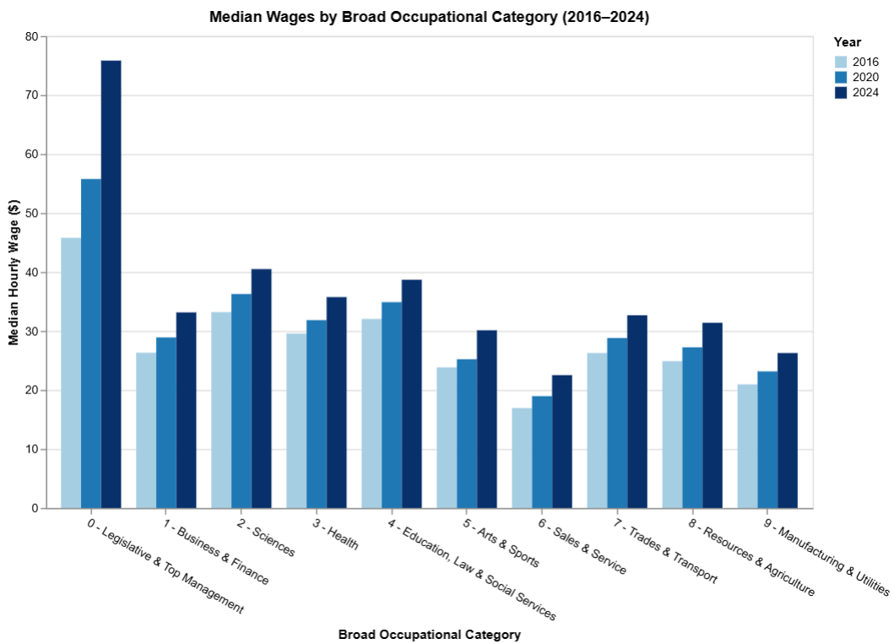
EDA - National-Level Insights
TEER is the strongest predictor of wages
Broad Occupational Category (BOC) shows secondary but noticeable impact
Consistent wage stratification:
TEER 0–1 → Highest wages
TEER 4–5 → Lowest wages
Stable patterns across 2016,
2020, and 2024 datasets

Slide 9
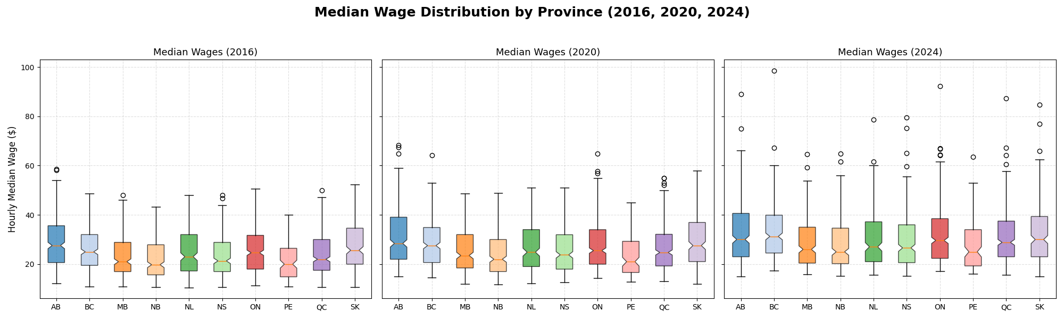
Provincial and Regional Analysis
Provinces have minor impact on wages compared to TEER
Alberta, BC, and Ontario show slightly higher median wages
Regional outliers identified in some economic zones
Regional effects are not significant overall

Slide 10
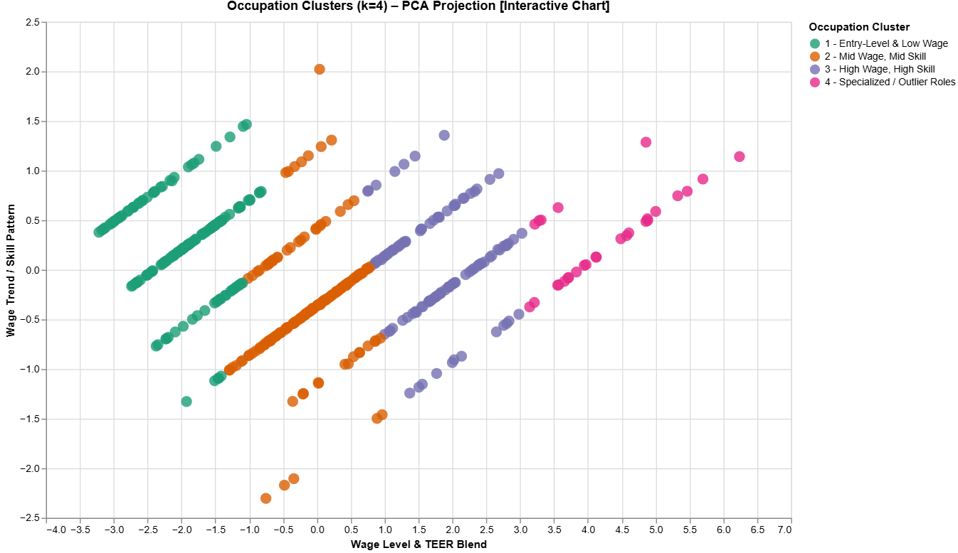
Pattern Detection via Clustering
K-Means and Hierarchical Clustering on occupational wage data
Clusters based on TEER level and median wages (2016–2024)
High TEER and skill level →
consistently higher wages
Wage structures are stable
across provinces
PCA confirms strong structure (first PC >95% variance)

Slide 11
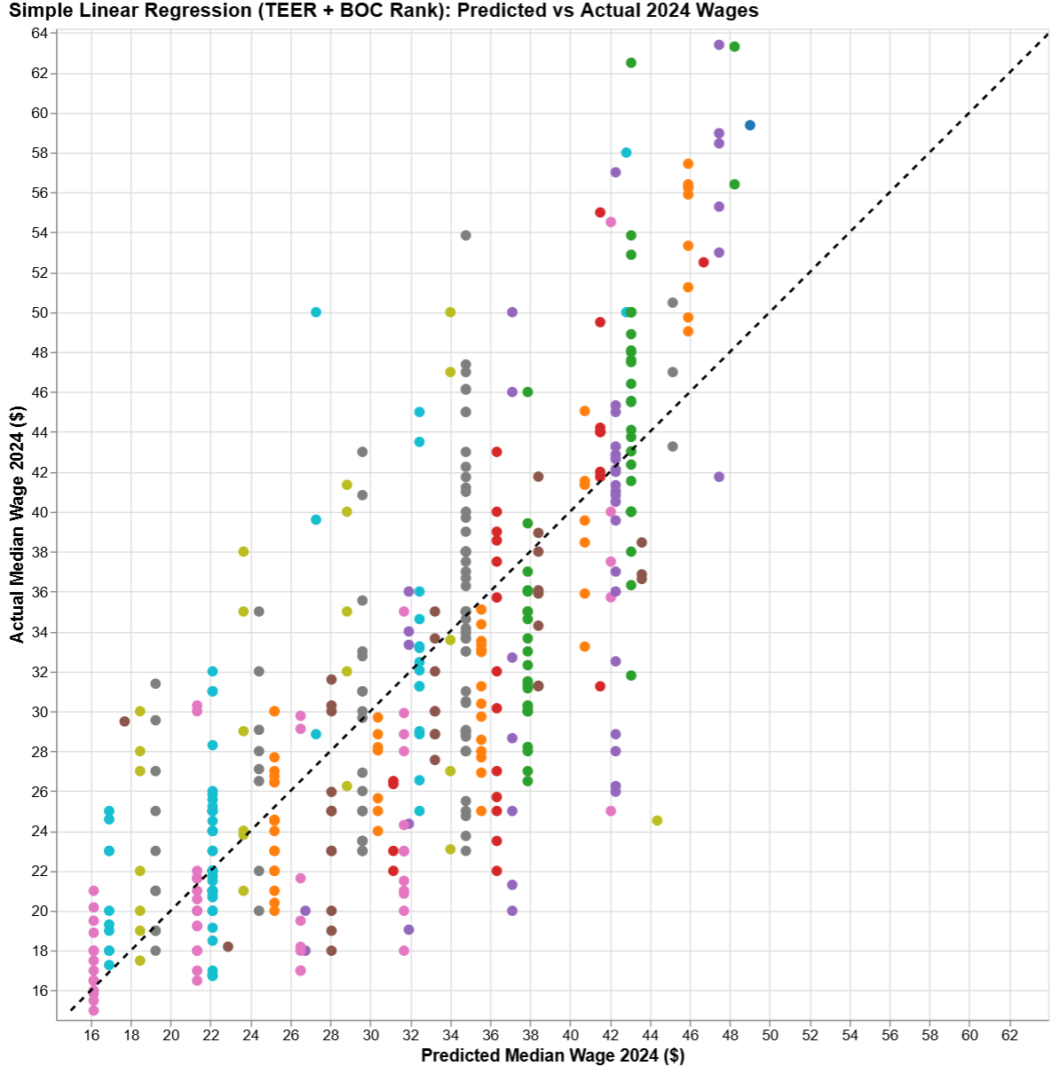
Supervised ML Wage Prediction
Built models using:
TEER, BOC, Province, Embedded Titles
Models:
Linear Regression, Random Forest, Gradient Boosting
Key Insight:
Simple models (TEER + BOC) perform
nearly as well as complex ones
Embedded titles add little predictive
power and risk overfitting

Slide 12
Wage Stability Modelling
Goal:
Predict 2024 wages using 2016 and 2020 data only
Models:
Linear Regression, Random Forest, Gradient Boosting
Results:
High accuracy (R² > 0.90)
Low RMSE across all models
Conclusion:
Wage growth patterns are highly stable and predictable,
even through global disruptions

Slide 13
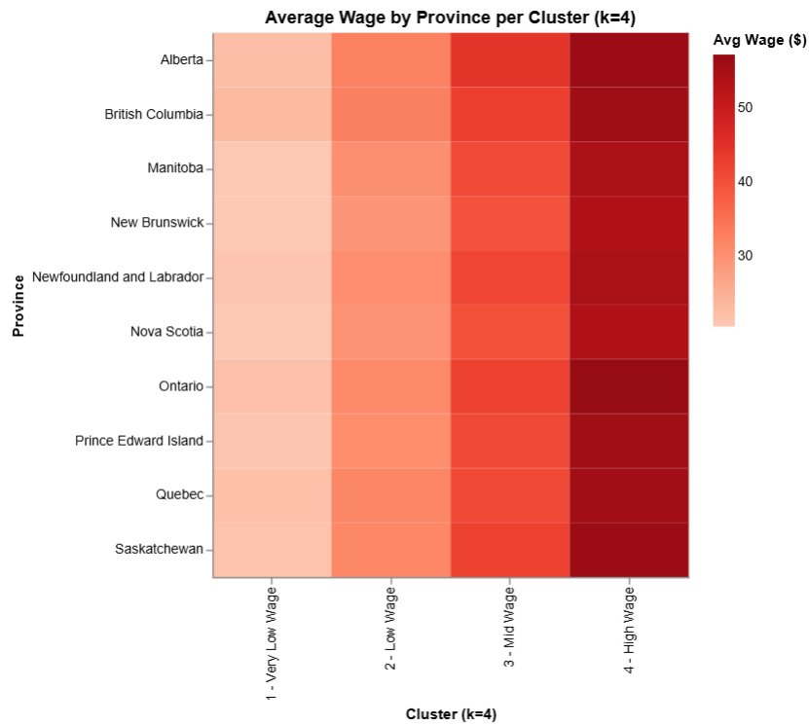
Evaluation - Correlation and Clustering
Strong negative TEER-wage correlation:
Pearson −0.75, Spearman −0.77
Moderate negative BOC-wage correlation:
Pearson −0.34, Spearman −0.31
Clustering validated:
Clear TEER-wage clusters
PCA >95% variance explained
Highest-paid clusters showed
higher dispersion

Slide 14
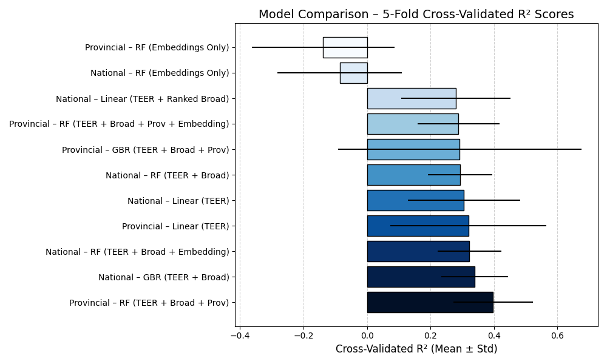
Evaluation – Model Performance
Compared models using
R² (explained variance) and RMSE (prediction error)
5-fold-cross-validation to assess generalization
Results:
TEER is the strongest predictor of wages
Adding BOC and Province
gives only minor gains
Embeddings caused clear
overfitting (negative R²)

Slide 15


Challenges & Solutions
NOC 2016 → NOC 2021 mapping:
Resolved with concordance tables + LLM assisted
refinement
Missing Values:
Imputed using national medians or removed
Data integrity:
Maintained across merged datasets
Pipeline design:
Modular pipeline built for efficient EDA and modelling

Slide 16



Potential Next Steps
Expand longitudinal modelling to future datasets (2026, 2028)
Communicate findings to Statistics Canada and stakeholders
Explore advanced modelling (e.g., neural networks with TensorFlow, PyTorch)
Monitor for structural shifts in labor markets over time

Slide 17
Biases and Limitations
Data Structure Bias: Dataset differences across years
Mapping Uncertainty: Potential manual errors during NOC transitions
Selection Bias: Excluded low-data territories
Overfitting Risk: Complex models showed optimism bias
External Factors: Future wage shifts (e.g., policy, technology) may break historical trends

Slide 18
Conclusion
TEER level remains the strongest predictor of wages
Wage structures were stable and predictable from 2016–2024
Provincial and regional effects are minor compared to training and education
GitHub Repository: https://github.com/nickshlepov/WageCAN_Project

